Slide 1


DAYANANDA SAGAR UNIVERSITY
SCHOOL OF ENGINEERING
Computer Science and Engineering (AIML)
Minor Project Phase-II
AIR CANVAS
Under the Supervision
Prof. Rakshita R
Presented By:
Pruthviraj SR(ENG22AM0042)
Rajat SU (ENG22AM0045)
Shashwat Dodamani(ENG22AM0058)
Shrinivas Sanjay Joshi(ENG22AM0062)
DR. SHREYAS RAJENDRA HOLE| CSE(AI&ML) DAYANANDA SAGAR UNIVERSITY
Notes:
Title of the project
CSE Dept., SET-Jain University

Slide 2
Content
Introduction
Problem Definition and Objectives
Mention Base Paper and Novelty of your Proposed Work
Detailed Methodology with Architectural Diagram
Experimentation
Code Execution
References
DR. SHREYAS RAJENDRA HOLE| CSE(AI&ML) DAYANANDA SAGAR UNIVERSITY
<number> of 12

Slide 3
Student Contribution
USN | Student Name | Contribution
ENG22AM0042 | Pruthviraj S R
ENG22AM0045 | Rajat S U
ENG22AM0058 | Shashwat Dodamani
ENG22AM0062 | Shrinivas Sanjay Joshi
DR. SHREYAS RAJENDRA HOLE| CSE(AI&ML) DAYANANDA SAGAR UNIVERSITY
(#) of 12

Slide 4
Sustainable Development Goals (SDGs)
Air Canvas project can align with Quality Education Sustainable Development Goal (SDG-4)
Innovative Learning
Inclusive Education
Promoting Lifelong Learning
DR. SHREYAS RAJENDRA HOLE| CSE(AI&ML) DAYANANDA SAGAR UNIVERSITY
(#) of 12

Slide 5
Introduction
What is AIR CANVAS?
An AI-powered solution that turns any wall or flat surface into an interactive whiteboard using just an ordinary RGB camera and your hand.
Utilizes deep learning models, such as YOLO for hand detection and a modified VGG16 for fingertip detection, allowing gesture-based interaction with the whiteboard.
Why is AIR CANVAS important?
Provides interactive whiteboard functionality without requiring expensive specialized hardware.
Enables natural gesture-based interaction, enhancing ease of use and collaboration.
Suitable for educational, professional, and creative tasks, allowing real-time control over digital content.
DR. SHREYAS RAJENDRA HOLE| CSE(AI&ML) DAYANANDA SAGAR UNIVERSITY
<number> of 12

Slide 6
Problem Definition and Objectives
  Problem: “Users in educational and professional settings struggle to make traditional whiteboards interactive and accessible for remote collaboration, requiring expensive hardware or manual transcription, which hampers efficiency..”
  Solution: The AIR CANVAS uses an ordinary RGB camera and hand gestures, powered by deep learning models (YOLO and VGG16), to turn any surface into an interactive digital whiteboard, offering an affordable and easy-to-use solution without specialized hardware
<number> of 12
DR. SHREYAS RAJENDRA HOLE| CSE(AI&ML) DAYANANDA SAGAR UNIVERSITY

Slide 7
Mention Base Paper and Novelty of your Proposed Work
DR. SHREYAS RAJENDRA HOLE| CSE(AI&ML) DAYANANDA SAGAR UNIVERSITY
(#) of 12

Slide 8
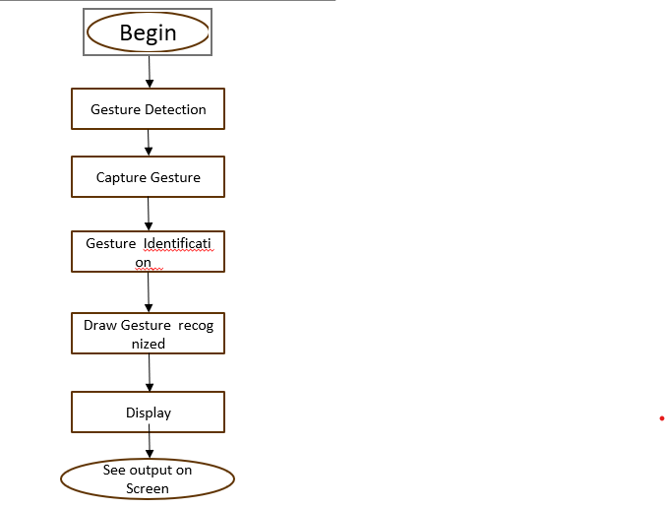
Model Architecture in detail
DR. SHREYAS RAJENDRA HOLE| CSE(AI&ML) DAYANANDA SAGAR UNIVERSITY
<number> of 12

Slide 9
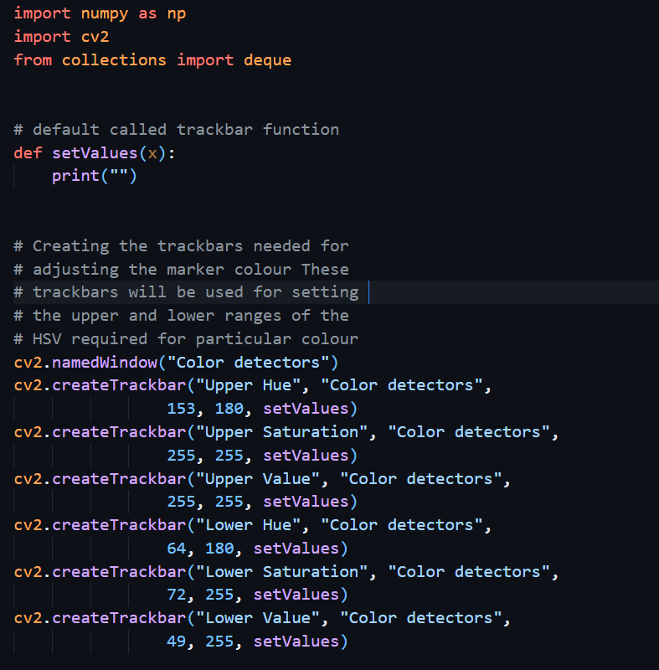
Code Execution with results
DR. SHREYAS RAJENDRA HOLE| CSE(AI&ML) DAYANANDA SAGAR UNIVERSITY
(#) of 12

Slide 10
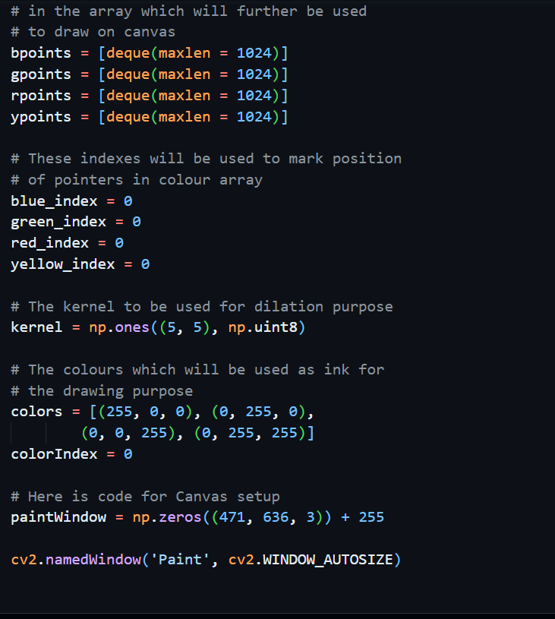
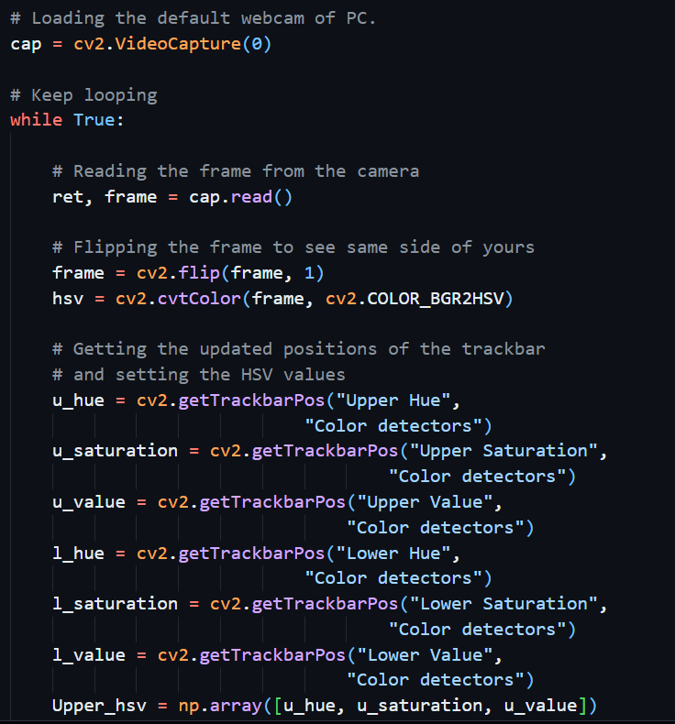
DR. SHREYAS RAJENDRA HOLE| CSE(AI&ML) DAYANANDA SAGAR UNIVERSITY
(#) of 12

Slide 11
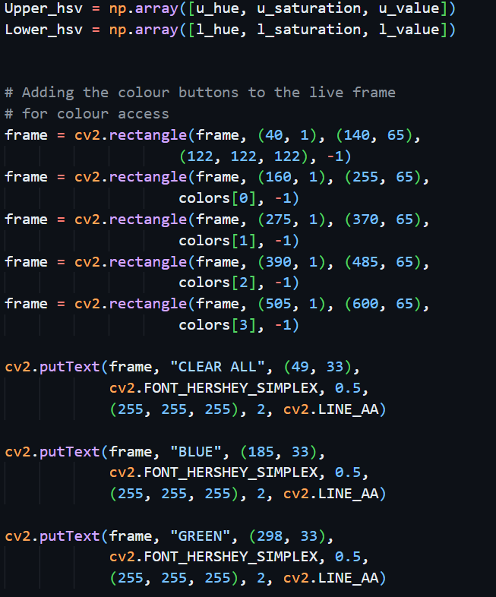
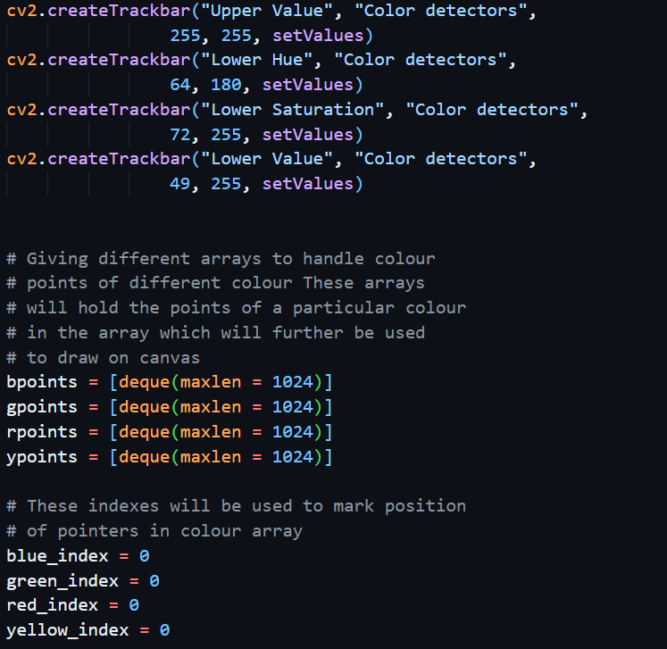
DR. SHREYAS RAJENDRA HOLE| CSE(AI&ML) DAYANANDA SAGAR UNIVERSITY
(#) of 12

Slide 12
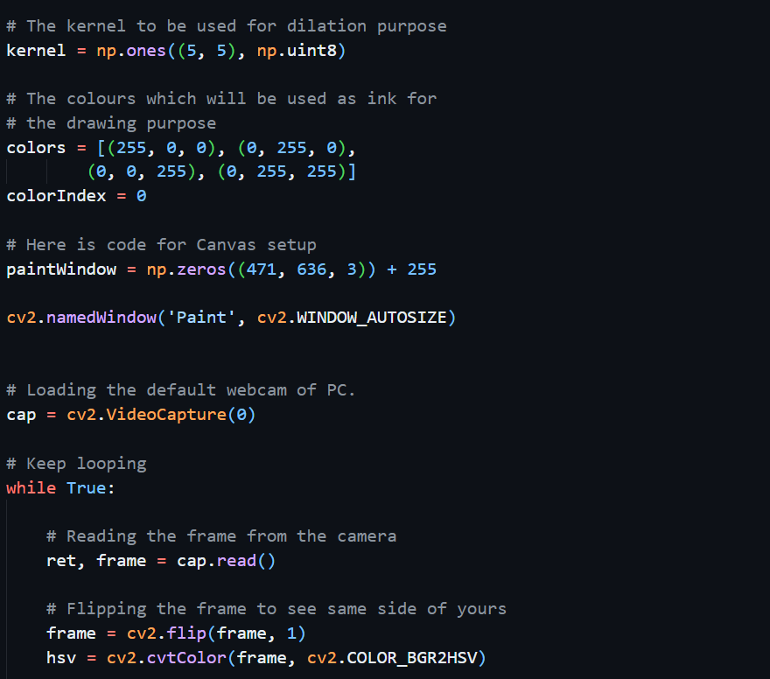
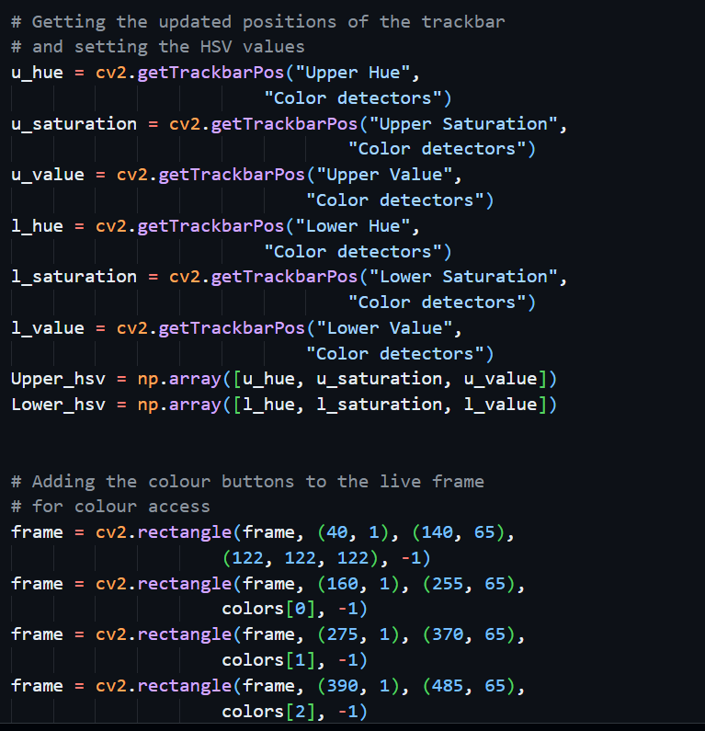
DR. SHREYAS RAJENDRA HOLE| CSE(AI&ML) DAYANANDA SAGAR UNIVERSITY
(#) of 12

Slide 13
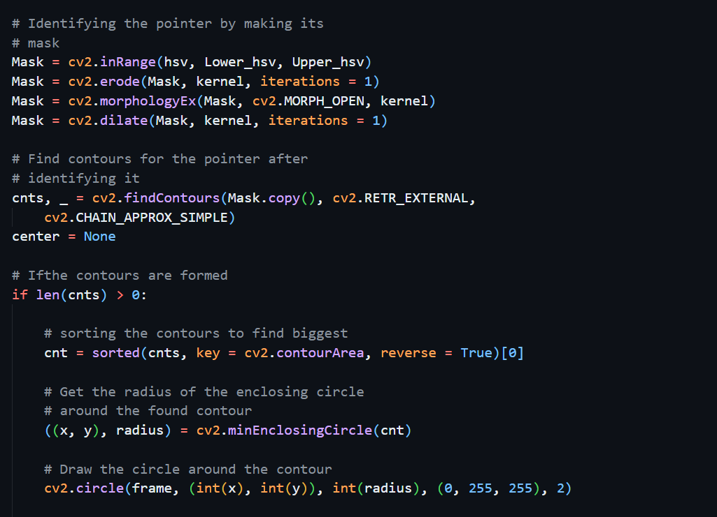
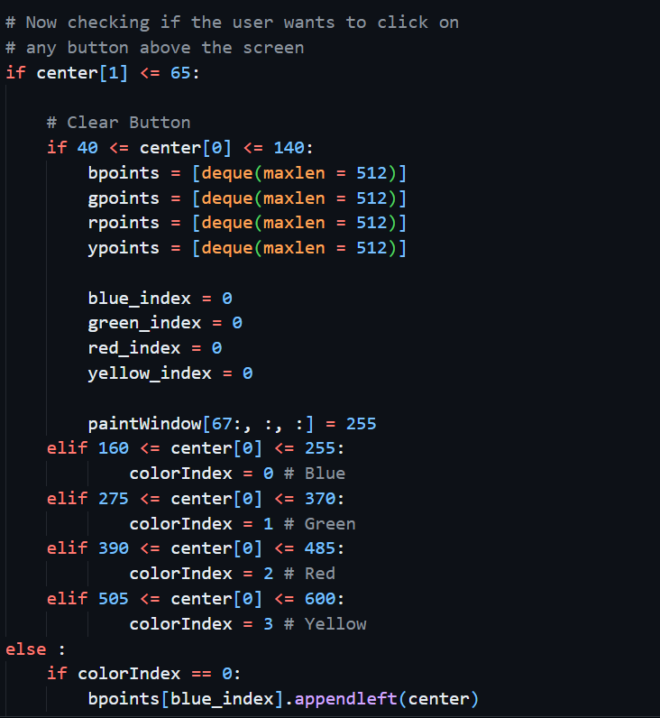

DR. SHREYAS RAJENDRA HOLE| CSE(AI&ML) DAYANANDA SAGAR UNIVERSITY
(#) of 12

Slide 14
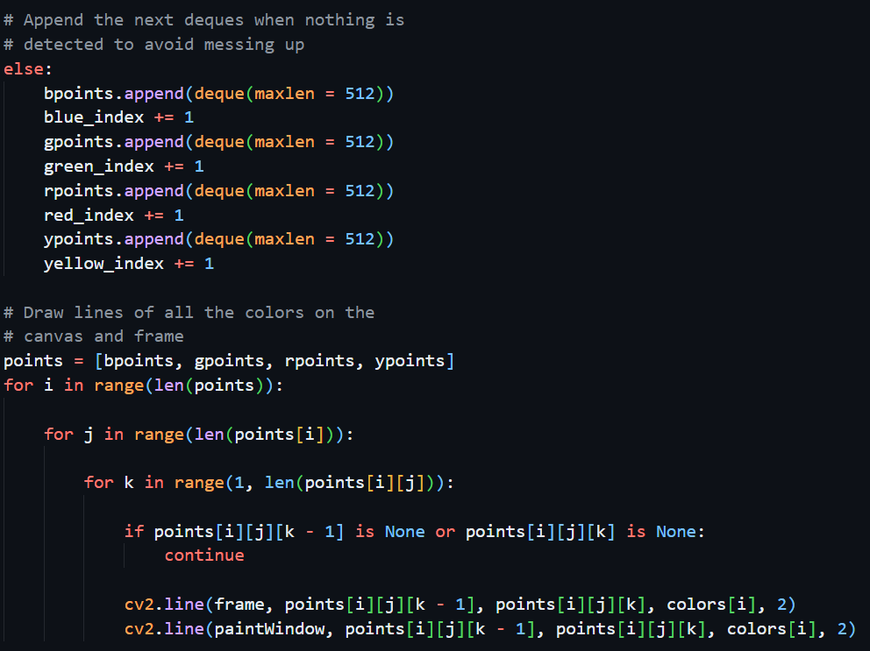
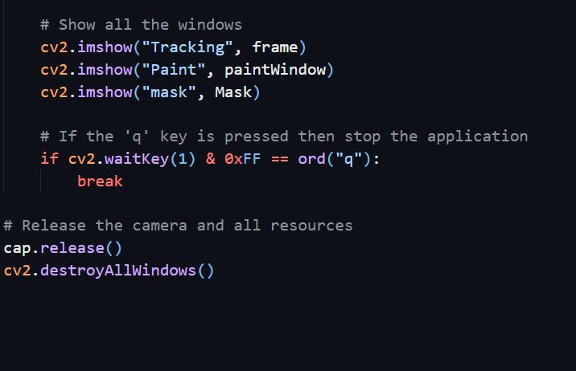
DR. SHREYAS RAJENDRA HOLE| CSE(AI&ML) DAYANANDA SAGAR UNIVERSITY
(#) of 12

Slide 15
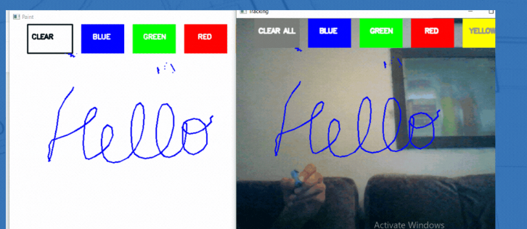
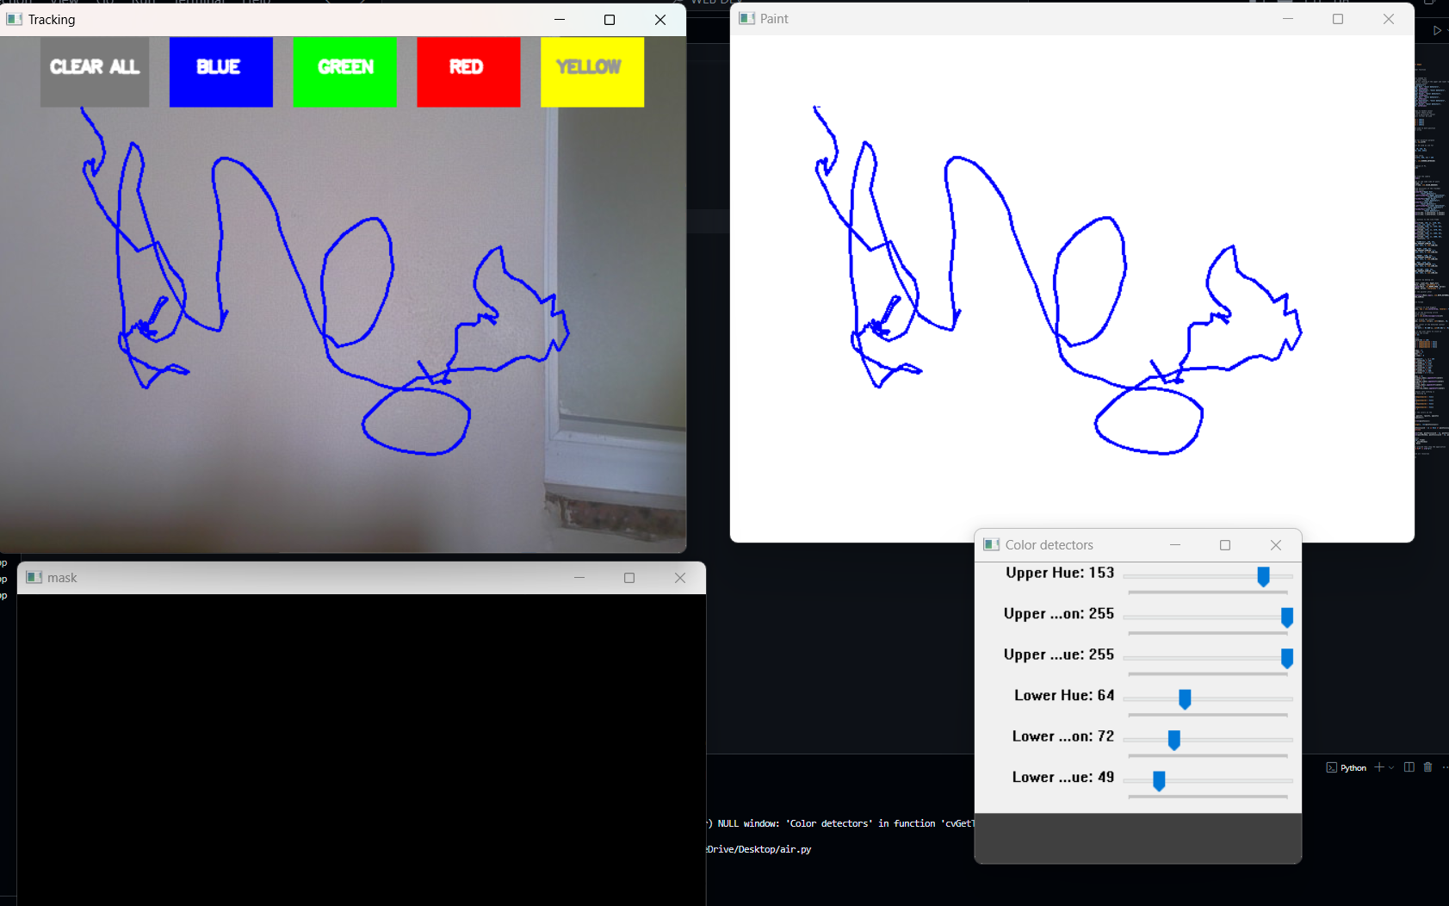
Output
DR. SHREYAS RAJENDRA HOLE| CSE(AI&ML) DAYANANDA SAGAR UNIVERSITY
(#) of 12

Slide 16
References
Smith, J., & Anderson, L. (2019). Air Canvas: Gesture-based Virtual Drawing Board. International Journal of Advanced Computer Science and Applications, 10(5), 85-90.
Patel, R., & Kumar, A. (2021). Real-Time Hand Gesture Recognition for Drawing in the Air. International Journal of Engineering Research and Technology, 14(2), 123-130.
Lee, H., & Wong, T. (2020). Air Canvas: Drawing on Thin Air using Kinect and Machine Learning. Journal of Computer Applications, 16(3), 55-62.
Garcia, M., & Rahman, F. (2022). Interactive Air Canvas Using Augmented Reality and Hand Tracking. Procedia Computer Science, 201, 45-52.
Shen, P., & Gupta, K. (2020). Gesture-based Air Canvas Using Smartphone Accelerometer. International Journal of Emerging Technologies in Computational and Applied Sciences, 19(4), 98-104.
Kumar, A., & Singh, R. (2021). Real-Time Hand Gesture Recognition for Drawing in the Air. International Journal of Engineering Research and Technology, 10(2), 345-351.
Chatterjee, M., & Verma, S. (2020). Air Canvas: Drawing on Thin Air using Kinect and Machine Learning. Journal of Computer Applications, 112(6), 56-62.
DR. SHREYAS RAJENDRA HOLE| CSE(AI&ML) DAYANANDA SAGAR UNIVERSITY
<number> of 12

